Slide 1
Chapter 4. Input/Output Organization
Computer Architecture and Organization

Slide 2
Overview
Computer has ability to exchange data with other devices.
Human-computer communication
Computer-computer communication
Computer-device communication
…

Slide 3
Accessing I/O Devices

Slide 4
Single Bus
Processor
Memory
Bus
I/O de
vice 1
I/O de
vice
n
Figure 4.1. A single-bus structure.

Slide 5
Memory-Mapped I/O
When I/O devices and the memory share the same address space, the arrangement is called memory-mapped I/O.
Any machine instruction that can access memory can be used to transfer data to or from an I/O device.
Move DATAIN, R0
Move R0, DATAOUT
Some processors have special In and Out instructions to perform I/O transfer.

Slide 6
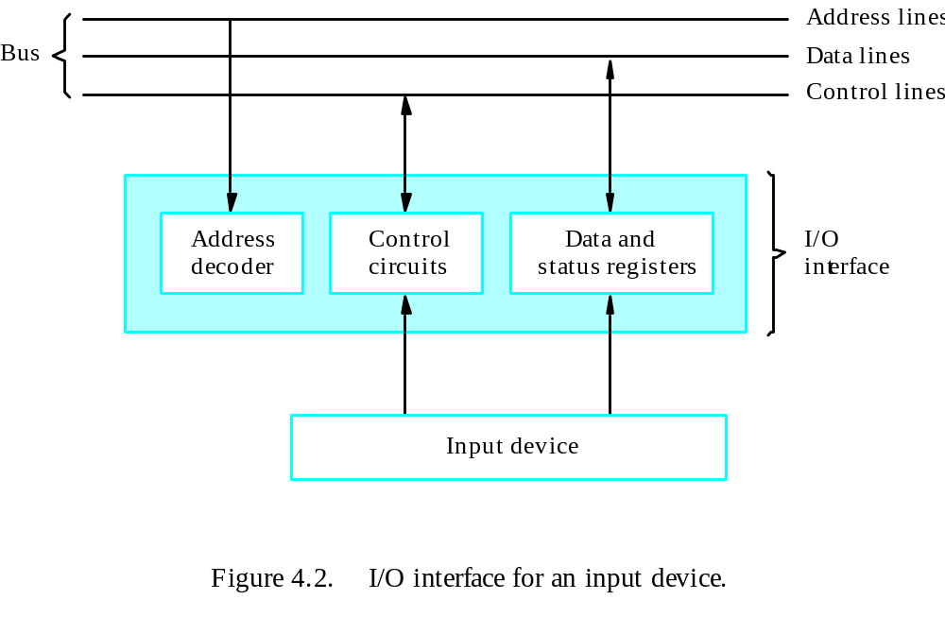
Interface

Slide 7
Program-Controlled I/O
I/O devices operate at speeds that are very much different from that of the processor.
Keyboard, for example, is very slow.
It needs to make sure that only after a character is available in the input buffer of the keyboard interface; also, this character must be read only once.

Slide 8
Three Major Mechanisms
Program-controlled I/O – processor polls the device.
Interrupt
Direct Memory Access (DMA)

Slide 9
In program-controlled I/O, the program enters a wait loop in which it repeatedly tests the device status. During the period, the processor is not performing any useful computation.
However, in many situations other tasks can be performed while waiting for an I/O device to become ready.
Let the device alert the processor.

Slide 10
Interrupts

Slide 11
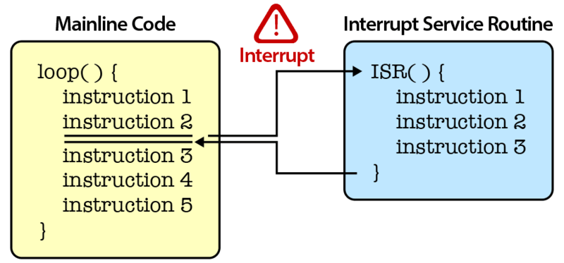
Overview
Interrupt request line –bus control line dedicated for interrupt request
Interrupt service routine- routine executed in service to interrupt request

Slide 12
Process informs device that interrupt req received by:
  Interrupt-acknowledge signal (explicit)
  Transfer of data btw processor and device interface (implicit)
Interrupt latency – delay btw interrupt request received and start of execution of ISR

Slide 13
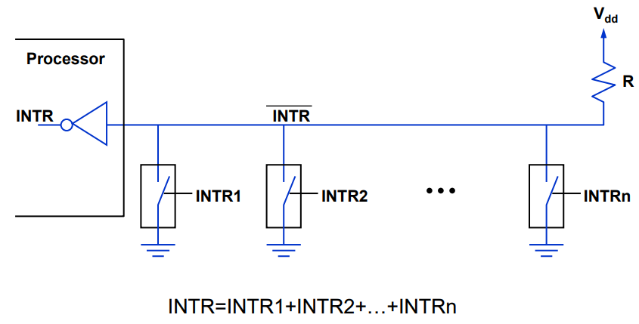
Interrupt hardware

Slide 14
Enabling and Disabling Interrupts
Since the interrupt request can come at any time, it may alter the sequence of events from that envisaged by the programmer.
Interrupts must be controlled.

Slide 15
Enabling and Disabling Interrupts
The interrupt request signal will be active until it learns that the processor has responded to its request. This must be handled to avoid successive interruptions.
Let the interrupt be disabled/enabled in the interrupt-service routine.
Let the processor automatically disable interrupts before starting the execution of the interrupt-service routine.

Slide 16
The device raises an interrupt request.
The processor interrupts the program currently being executed and saves the contents of the PC and PS registers.
Interrupts are disabled by clearing the IE bit in the PS to 0.
The action requested by the interrupt is performed by the interrupt-service routine
  device is informed that its request has been recognized,
  it deactivates the interrupt-request signal.
Upon completion of the interrupt-service routine,
  the saved contents of the PC and PS registers are restored (enabling interrupts by setting the IE bit to 1)
  execution of the interrupted program is resumed.

Slide 17
Handling Multiple Devices
How can the processor recognize the device requesting an interrupt?
Given that different devices are likely to require different interrupt-service routines, how can the processor obtain the starting address of the appropriate routine in each case?
(Vectored interrupts)
Should a device be allowed to interrupt the processor while another interrupt is being serviced?
(Interrupt nesting)
How should two or more simultaneous interrupt requests be handled?
(Daisy-chain)

Slide 18
Vectored Interrupts
A device requesting an interrupt can identify itself by sending a special code to the processor over the bus.
Interrupt vector
Avoid bus collision

Slide 19
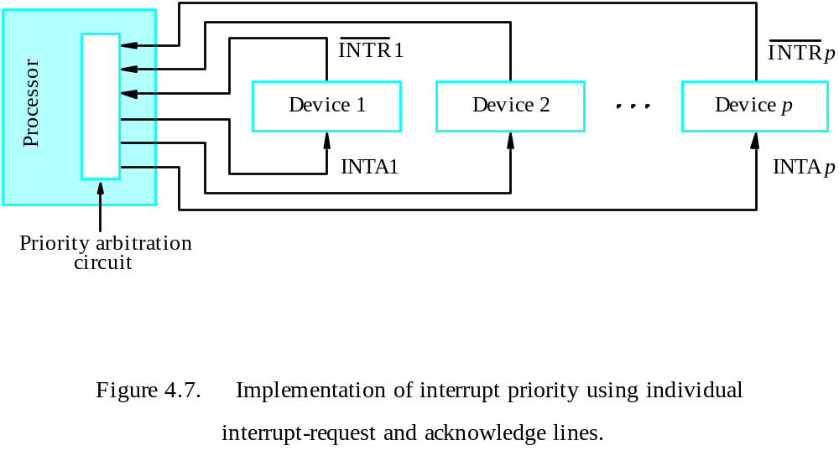
Interrupt Nesting
Simple solution: only accept one interrupt at a time, then disable all others.
Problem: some interrupts cannot be held too long.
Priority structure

Slide 20
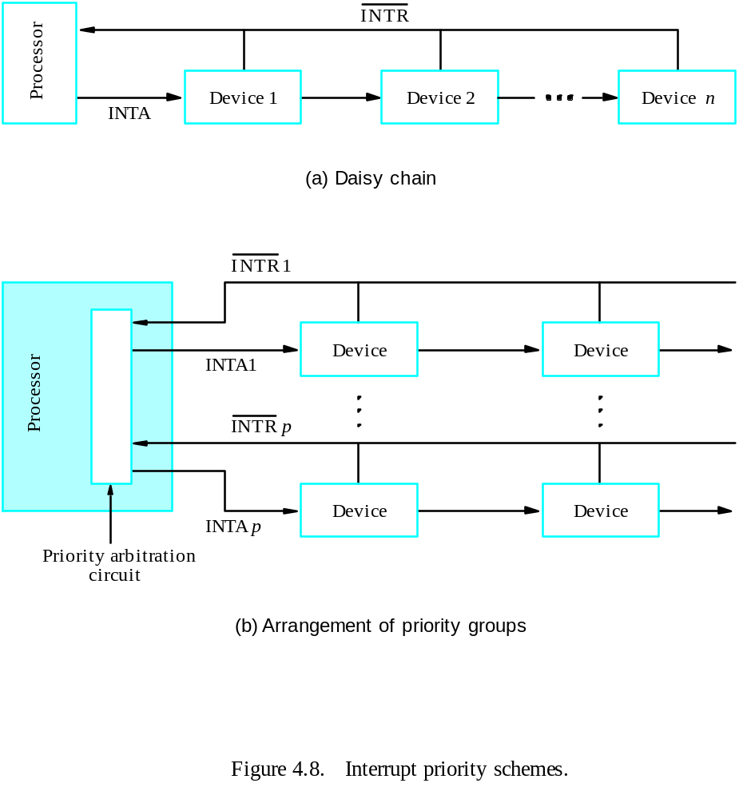
Simultaneous Requests

Slide 21
Controlling Device Requests
Some I/O devices may not be allowed to issue interrupt requests to the processor.
At device end, an interrupt-enable bit in a control register determines whether the device is allowed to generate an interrupt request.
At processor end, either an interrupt enable bit in the PS register or a priority structure determines whether a given interrupt request will be accepted.

Slide 22
Exceptions
Recovery from errors
Debugging
Trace
Breakpoint
Privilege exception

Slide 23
Use of Interrupts in Operating Systems
The OS and the application program pass control back and forth using software interrupts.
Supervisor mode / user mode
Multitasking (time-slicing)
Process – running, runnable, blocked
Program state

Slide 24
Processor Examples

Slide 25
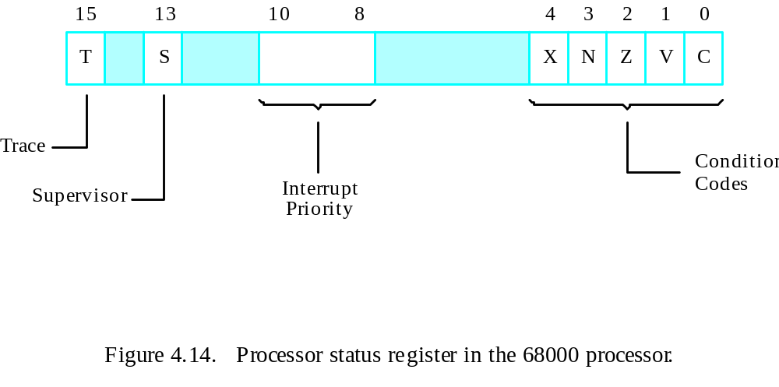

Slide 26
Main
program
MO
VE.L
#LINE,PNTR
Initialize
buffer
p
oin
ter.
CLR
EOL
Clear
end-of-line
indicator.
ORI.B
#4,CONTR
OL
Set
bit
KEN.
MO
VE
#$100,SR
Set
pro
cessor
priorit
y
to
1.
.
.
.
In
terrupt-service
routine
READ
MO
VEM.L
A0/D0,
–
(A7)
Sa
v
e
registers
A0,
D0
on
stac
k.
MO
VEA.L
PNTR,A0
Load
address
p
oin
ter.
MO
VE.B
D
A
T
AIN,D0
Get
input
c
haracter.
MO
VE.B
D0,(A0)+
Store
it
in
memory
buffer.
MO
VE.L
A0,PNTR
Up
date
p
oin
ter.
CMPI.B
#$0D,D0
Chec
k
if
Carriage
Return.
BNE
R
TRN
MO
VE
#1,EOL
Indicate
end
of
line.
ANDI.B
#$FB,CONTR
OL
Clear
bit
KEN.
R
TRN
MO
VEM.L
(A7)+,A0/D0
Restore
registers
D0,
A0.
R
TE
Figure 4.15. A 68000 interrupt-service routine to read an input line from a keyboard based on Figure 4.9.

Slide 27
Direct Memory Access

Slide 28
DMA
Think about the overhead in both polling and interrupting mechanisms when a large block of data need to be transferred between the processor and the I/O device.
A special control unit may be provided to allow transfer of a block of data directly between an external device and the main memory, without continuous intervention by the processor – direct memory access (DMA).
The DMA controller provides the memory address and all the bus signals needed for data transfer, increment the memory address for successive words, and keep track of the number of transfers.

Slide 29
DMA Procedure
Processor sends the starting address, the number of data, and the direction of transfer to DMA controller.
Processor suspends the application program requesting DMA, starts DMA transfer, and starts another program.
After the DMA transfer is done, DMA controller sends an interrupt signal to the processor.
The processor puts the suspended program in the Runnable state.

Slide 30
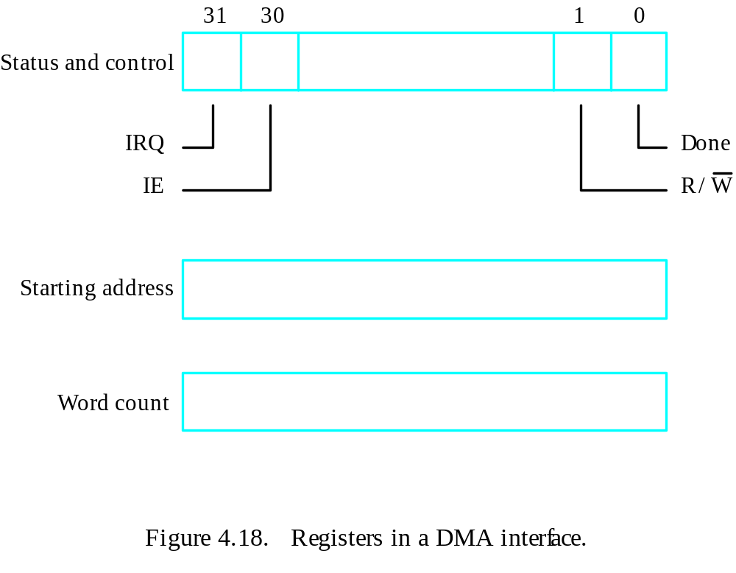
DMA Register

Slide 31
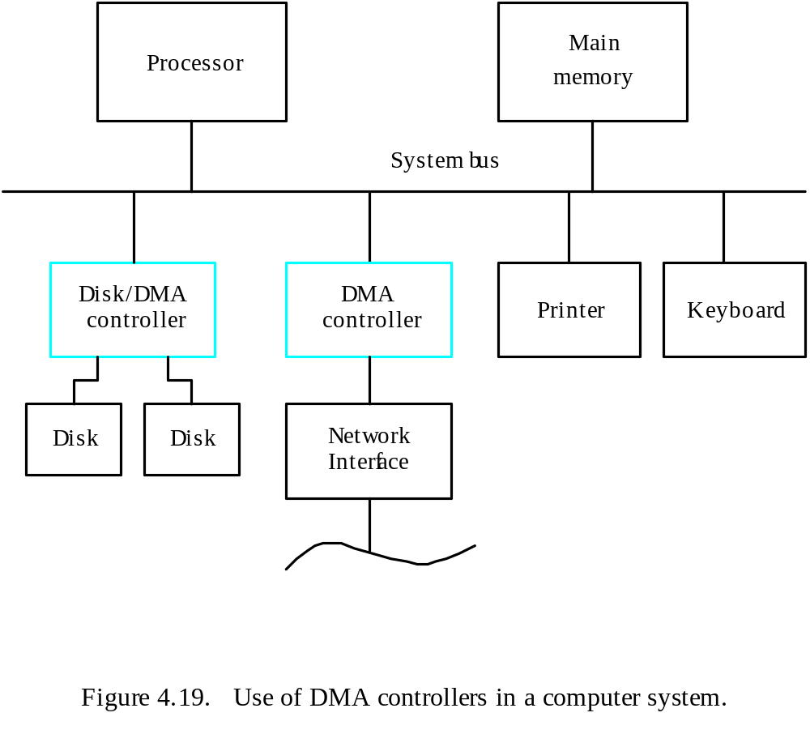
System

Slide 32
Memory Access
Memory access by the processor and the DMA controller are interwoven.
DMA device has higher priority.
Among all DMA requests, top priority is given to high-speed peripherals.
Cycle stealing
Block (burst) mode
Data buffer
Conflicts

Slide 33
Bus Arbitration
The device that is allowed to initiate data transfers on the bus at any given time is called the bus master.
Bus arbitration is the process by which the next device to become the bus master is selected and bus mastership is transferred to it.
Need to establish a priority system.
Two approaches: centralized and distributed

Slide 34
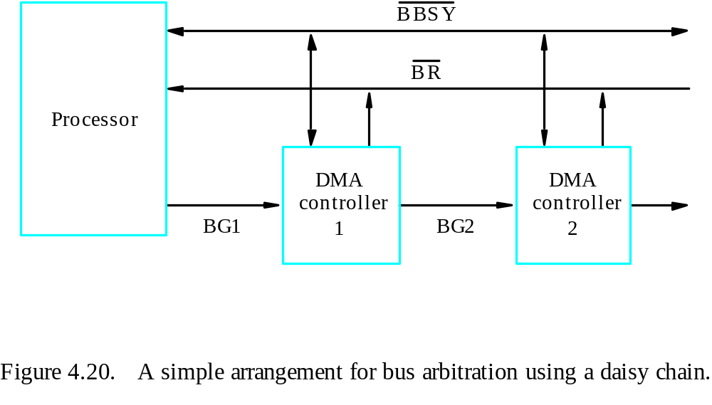
Centralized Arbitration

Slide 35
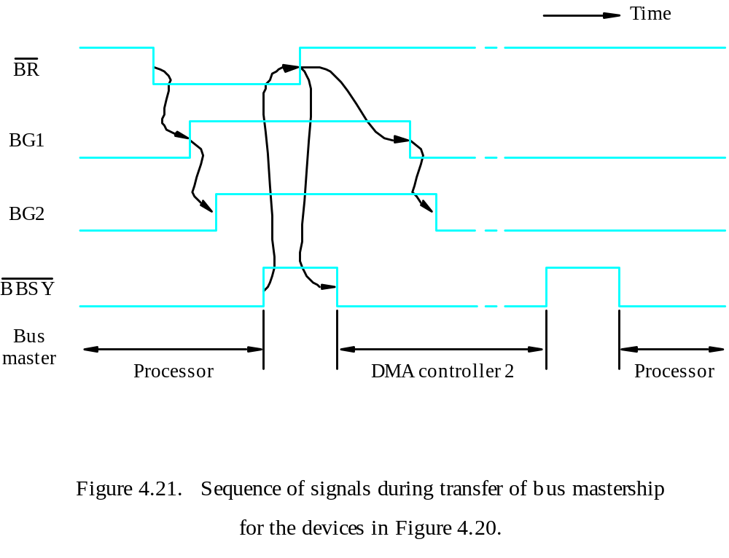
Centralized Arbitration

Slide 36
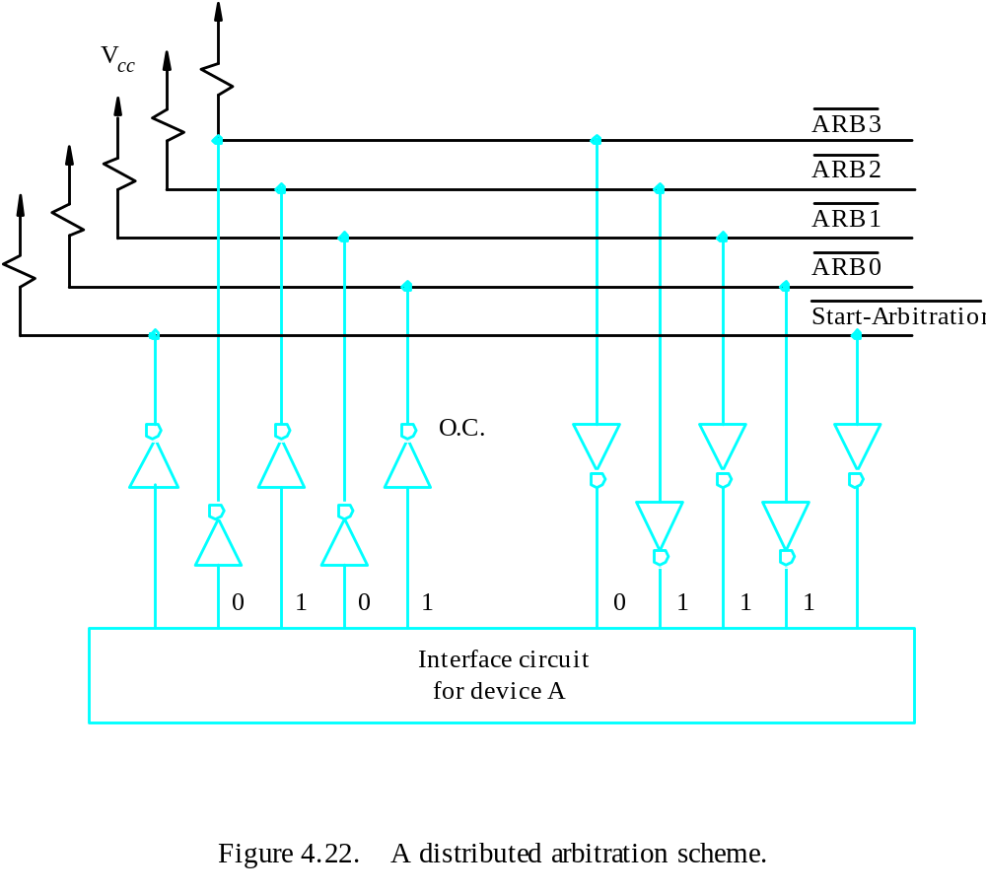
Distributed Arbitration

Slide 37
Buses

Slide 38
Overview
The primary function of a bus is to provide a communications path for the transfer of data.
A bus protocol is the set of rules that govern the behavior of various devices connected to the bus as to when to place information on the bus, assert control signals, etc.
Three types of bus lines: data, address, control
The bus control signals also carry timing information.
Bus master (initiator) / slave (target)

Slide 39
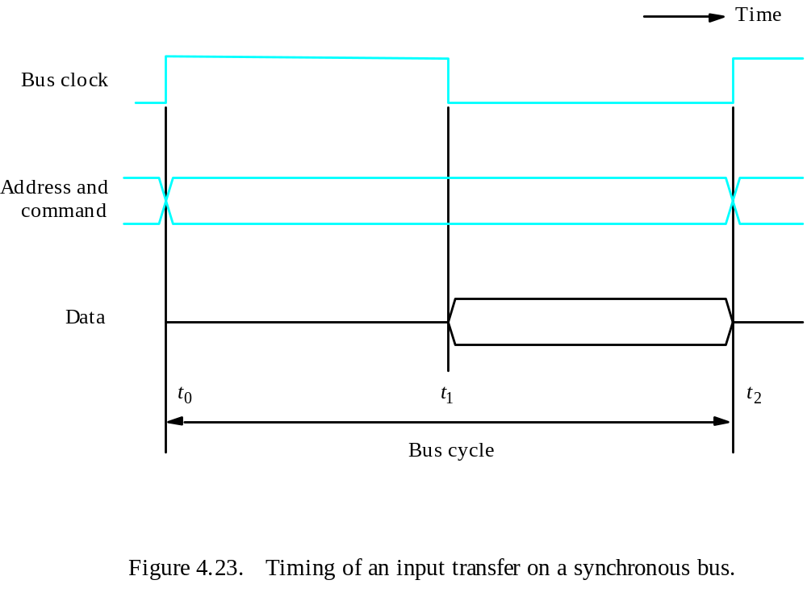
Synchronous Bus Timing

Slide 40
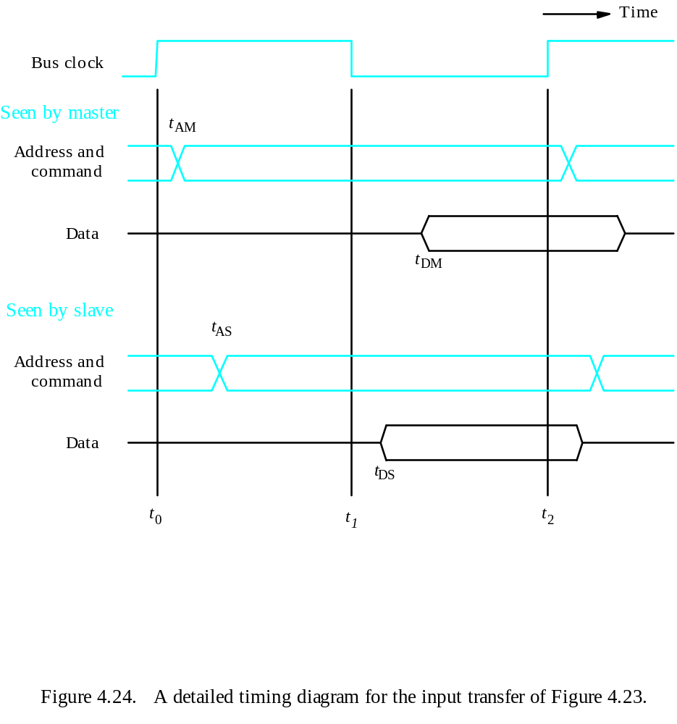
Synchronous Bus Detailed Timing

Slide 41
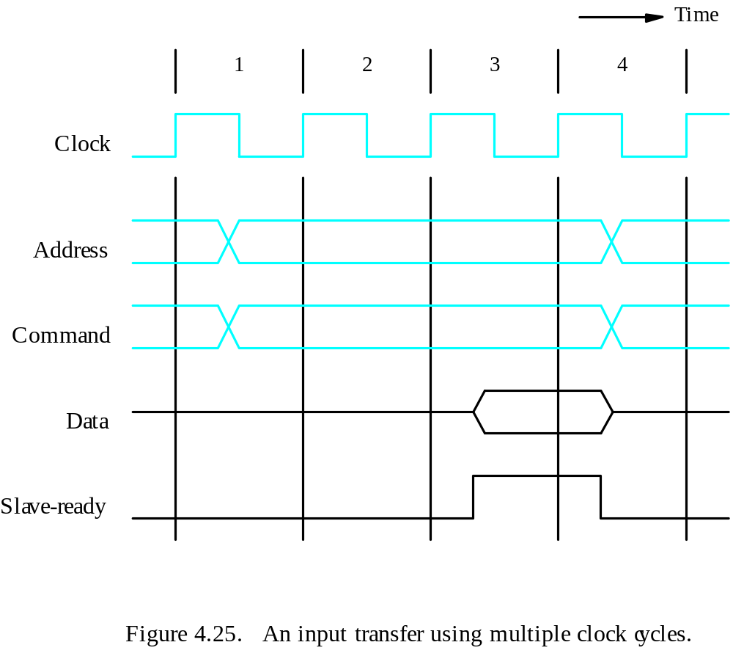
Multiple-Cycle Transfers

Slide 42
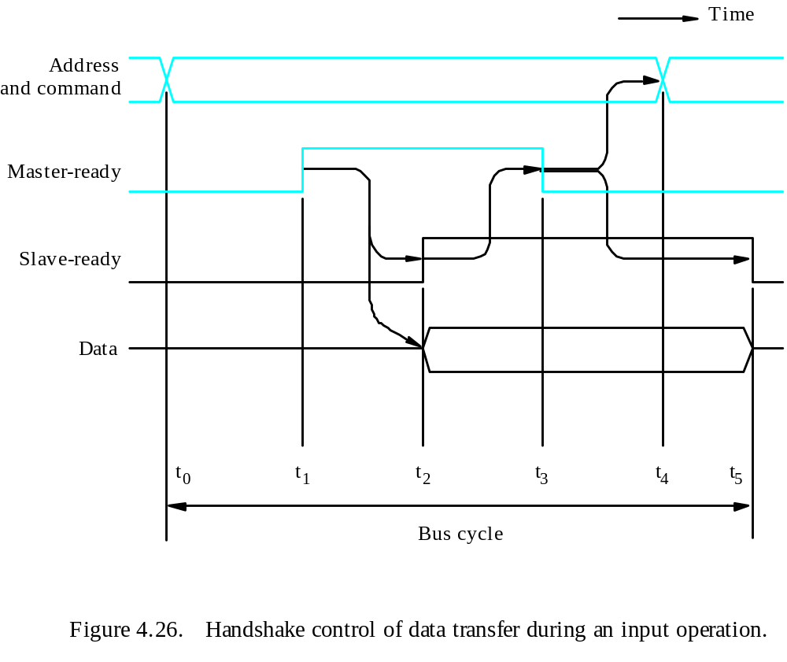
Asynchronous Bus – Handshaking Protocol for Input Operation

Slide 43
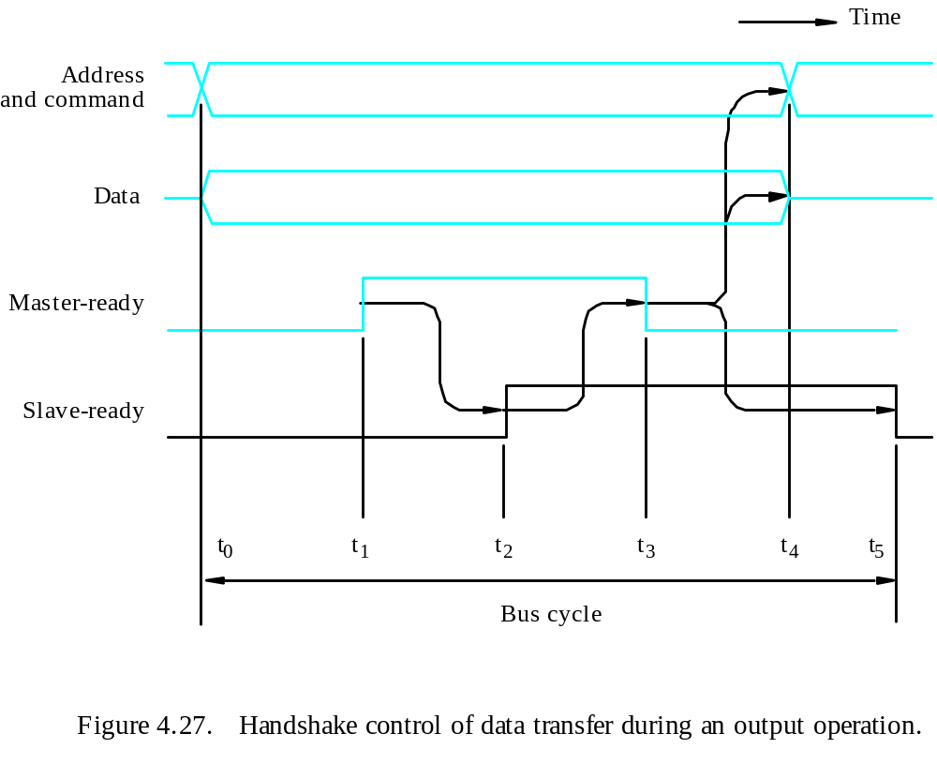
Asynchronous Bus – Handshaking Protocol for Output Operation

Slide 44
Discussion
Trade-offs
Simplicity of the device interface
Ability to accommodate device interfaces that introduce different amounts of delay
Total time required for a bus transfer
Ability to detect errors resulting from addressing a nonexistent device or from an interface malfunction
Asynchronous bus is simpler to design.
Synchronous bus is faster.

Slide 45
Interface Circuits

Slide 46
Function of I/O Interface
Provide a storage buffer for at least one word of data;
Contain status flags that can be accessed by the processor to determine whether the buffer is full or empty;
Contain address-decoding circuitry to determine when it is being addressed by the processor;
Generate the appropriate timing signals required by the bus control scheme;
Perform any format conversion that may be necessary to transfer data between the bus and the I/O device.

Slide 47
Parallel Port
A parallel port transfers data in the form of a number of bits, typically 8 or 16, simultaneously to or from the device.
For faster communications

Slide 48
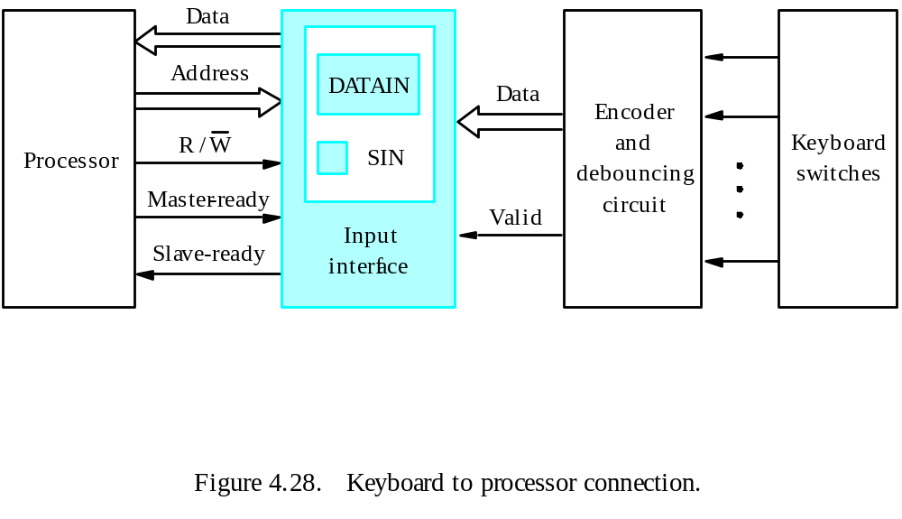
Parallel Port – Input Interface (Keyboard to Processor Connection)

Slide 49
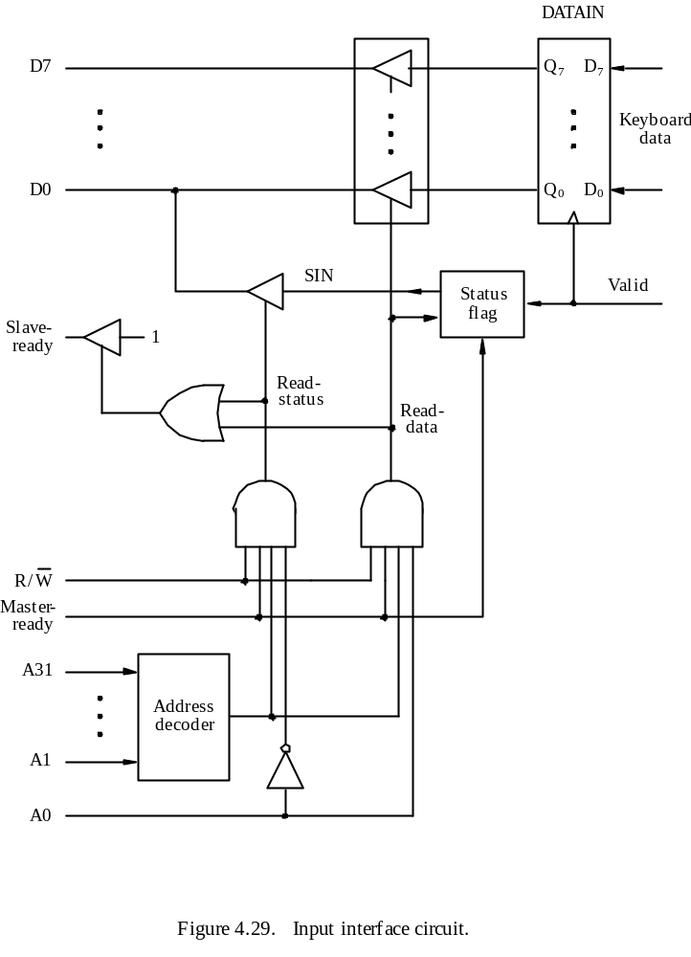

Slide 50
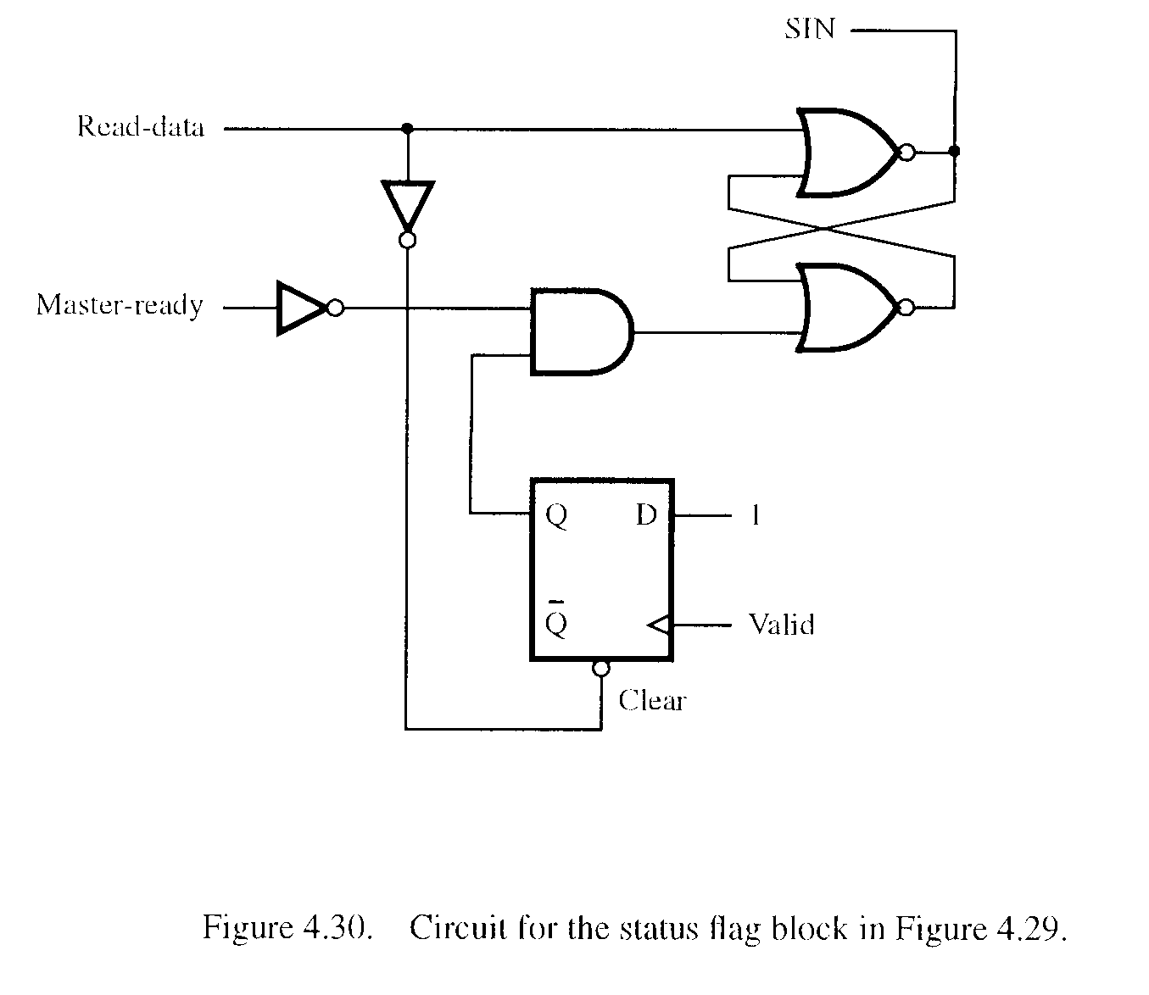
Parallel Port – Input Interface (Keyboard to Processor Connection)

Slide 51
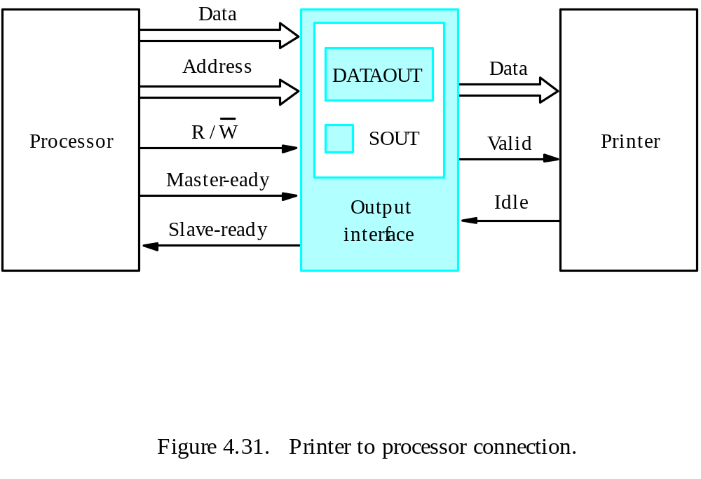
Parallel Port – Output Interface (Printer to Processor Connection)

Slide 52
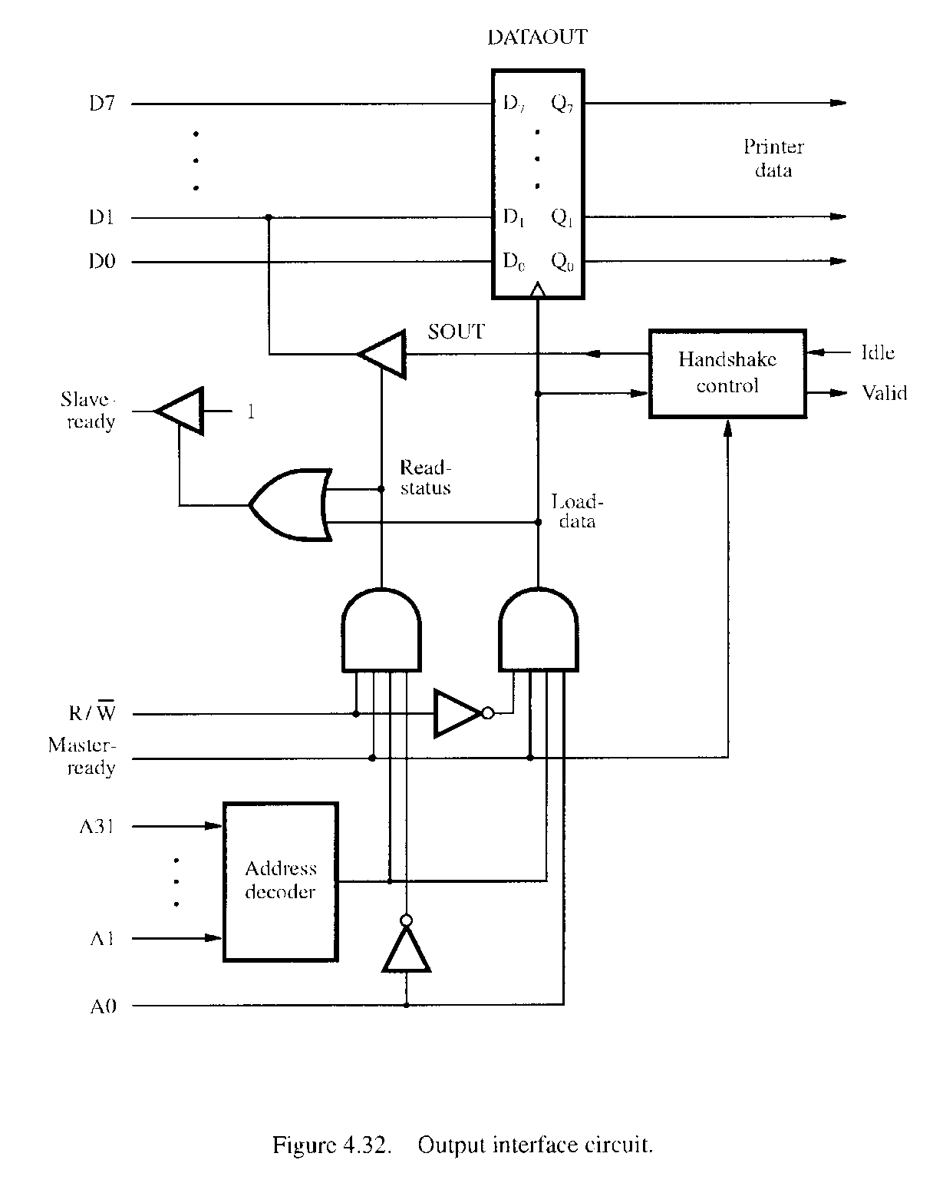

Slide 53
D7
Bus
P
A7
D
A
T
AIN
D1
D0
P
A0
SIN
Input
CA
status
PB7
D
A
T
A
OUT
PB0
SOUT
Handshak
e
CB1
control
CB2
Sla
v
e-
1
Ready
Master
-
Ready
R
/
W
A31
Address
My-address
decoder
A2
A1
RS1
A0
RS0
Figure 4.33. Combined input/output interface circuit.

Slide 54
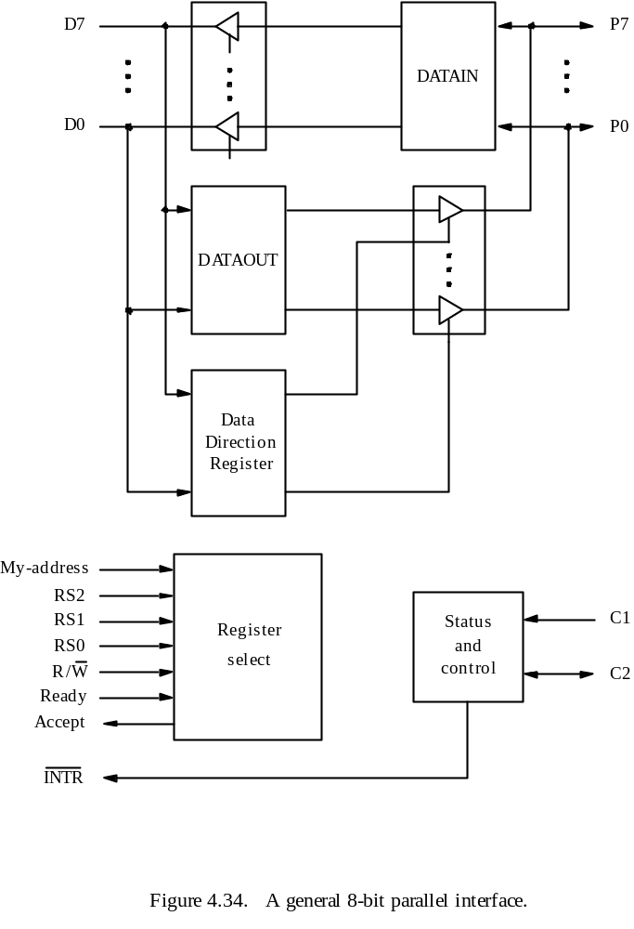

Slide 55
Recall the Timing Protocol

Slide 56
D
A
T
A
OUT
D7
D
7
Q
7
Printer
data
D0
D
1
Q
1
D0
D
0
Q
0
SOUT
Handshak
Idle
control
e
V
alid
Read
Load
status
data
R/
W
Sla
v
e-
ready
Go
A31
Address
My-address
T
iming
decoder
Logic
A1
A0
Clock
My-address
Idle
Respond
Go=1
Figure 4.35. A parallel point interface for the bus of Figure 4.25,
with a state-diagram for the timing logic.

Slide 57
Serial Port
A serial port is used to connect the processor to I/O devices that require transmission of data one bit at a time.
The key feature of an interface circuit for a serial port is that it is capable of communicating in bit-serial fashion on the device side and in a bit-parallel fashion on the bus side.
Capable of longer distance communication than parallel transmission.

Slide 58
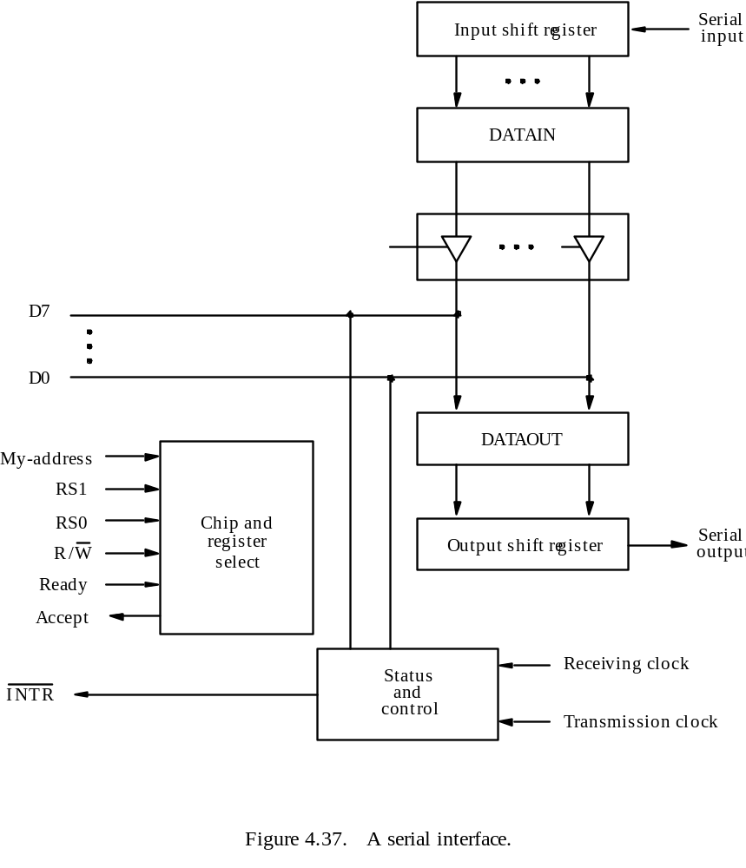

Slide 59
Standard I/O Interfaces

Slide 60
Overview
The needs for standardized interface signals and protocols.
Motherboard
Bridge: circuit to connect two buses
Expansion bus
ISA, PCI, SCSI, USB,…

Slide 61
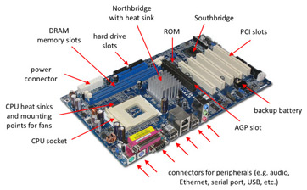

Slide 62
Processor
Main
memory
Processor b
us
Bridge
PCI b
us
Additional
SCSI
Ethernet
USB
ISA
memory
controller
interf
ace
controller
interf
ace
SCSI b
us
IDE
V
ideo
disk
Disk
CD-R
OM
controller
controller
Disk 1
Disk 2
CD-
K
e
yboard
Game
R
OM
Figure 4.38. An example of a computer system using different interface standards.

Slide 63
PCI
Connected to processor via bridge
Supports 3 address spaces:
  Memory
  I/O
  Configuration
Signalling
  Same line to transfer data and address
  Address from the master saved by slave, then used for data transfer

Slide 64
Data transfer-PCI
Data transfer
  Burst of data(several words) transferred at once
  Transaction- address+burst of data
  Initiator,target

Slide 65
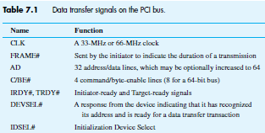
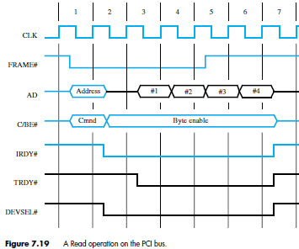

Slide 66
SCSI
Main use- to connect disk drives
Data transfer 8 bits(narrow)/16 bits(wide) parallel
Transmission:
  Single ended
  Differential
    High Voltage differential (5V)
    Low Voltage Differential (3.3 V)

Slide 67
Data transfer
Data transferred in the form of multibyte messages-packets
SCSI controller uses DMA for data packet transfer
Controller:
  Initiator: select particular target,send commands
  Target: controls the transfer

Slide 68

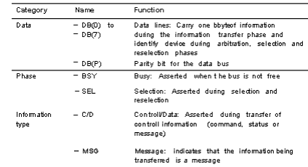
SCSI bus signals

Slide 69
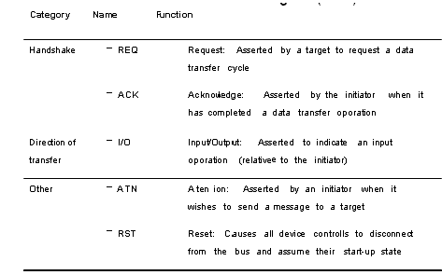
SCSI bus signals

Slide 70
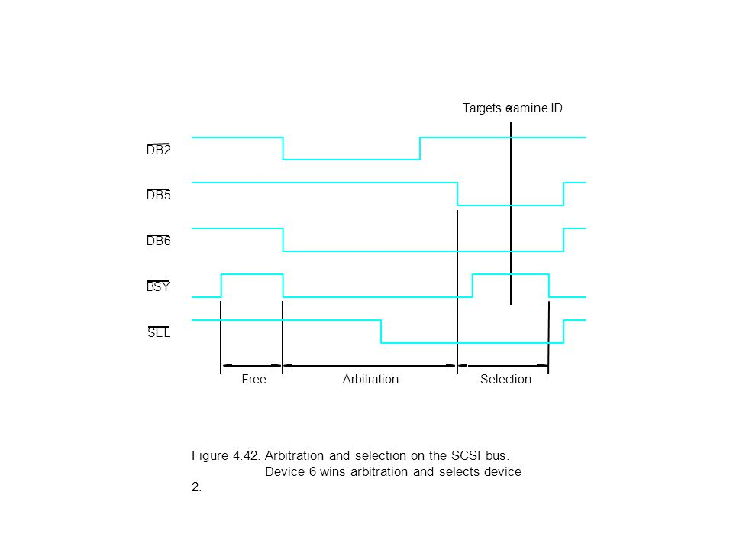
Bus arbitration

Slide 71
USB
Single connector type
  Replaces all different legacy connectors with one well defined USB connector for all USB peripheral devices
Plug and play
  OS software automatically identifies, configures and loads appropriate driver when connection is made
Hot swappable
  Devices can be safely plugged and unplugged as needed when the computer is running
Accommodate wide range of data transfer characteristics

Slide 72
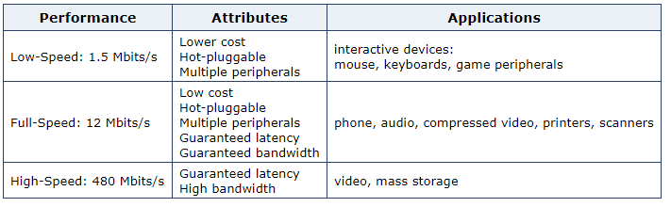
Isochronous data stream: successive events separated by equal time period
Supports Low-Speed, Full-Speed and High-Speed.

Slide 73
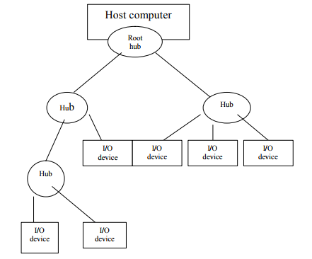
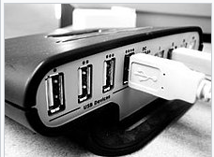

Slide 74
Works by polling
Device send message only as response to poll by host processor
Pipes: links between application software and I/O devices

Slide 75
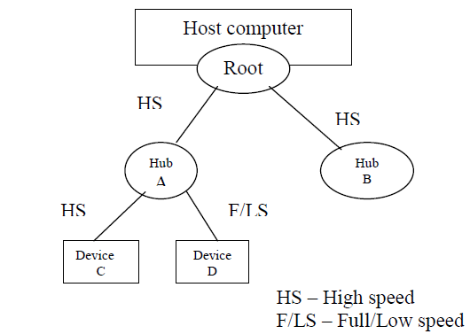
Split bus operation

Slide 76
Addressing
Each device -7 bit address
Address local to USB
Initial connection procedure:
  Initially, hub address is 0
  Host polls each hub to collect info about connected devices and assigns address to it
Endpoints:
  status, control, data registers inside device
  Identified by 4 bit number
  Pipe connected to one end point

Slide 77
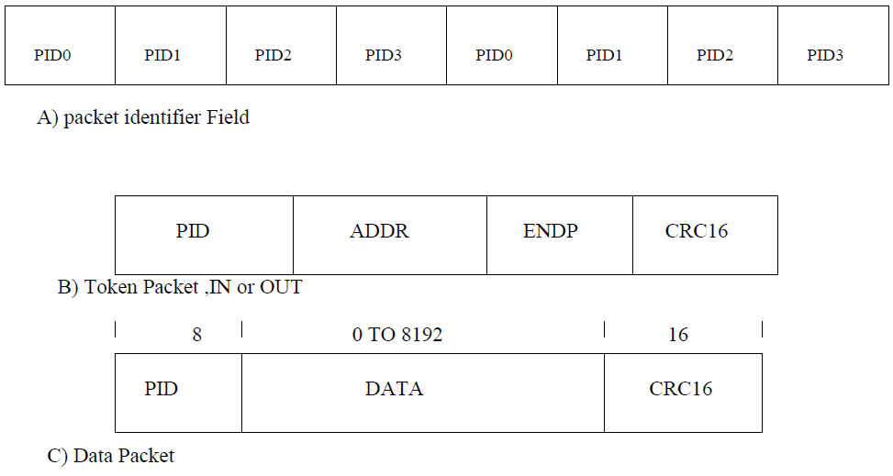
USB protocols
Information transferred as packets
  1. Control 2. Data
    Addressing
    Acknowledgement
    Error reporting

Slide 78
